Slide 1
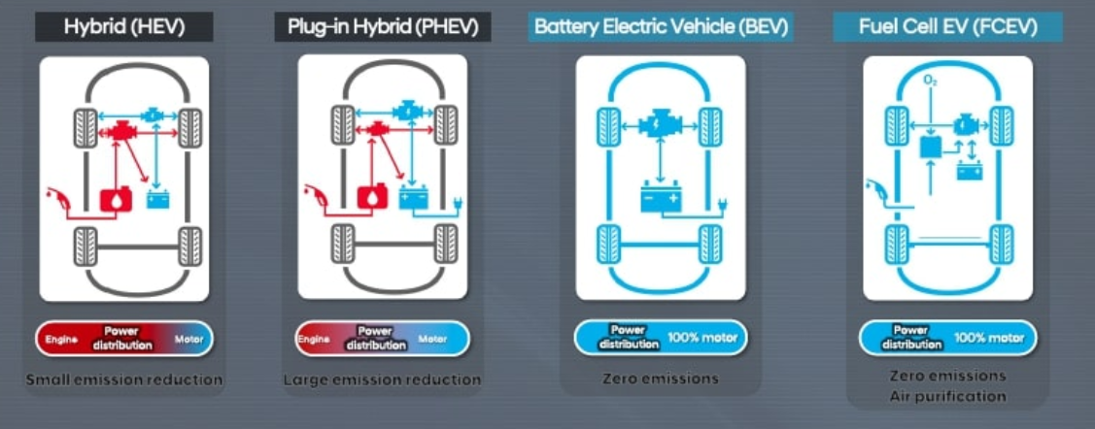
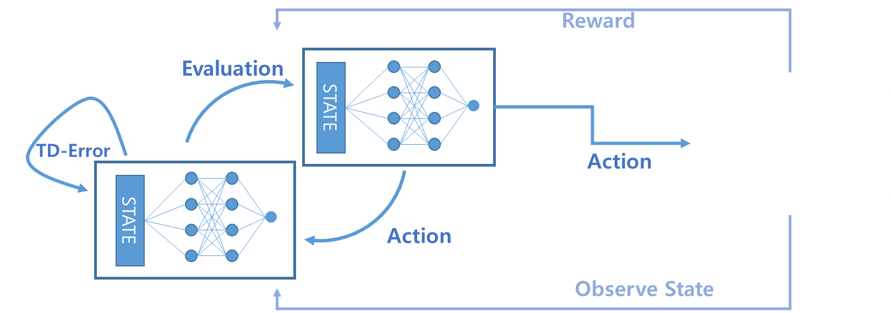
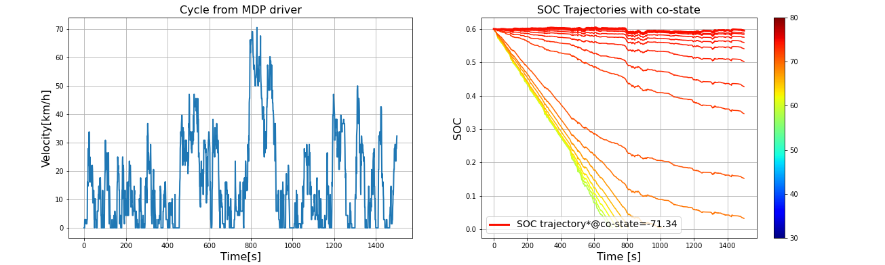
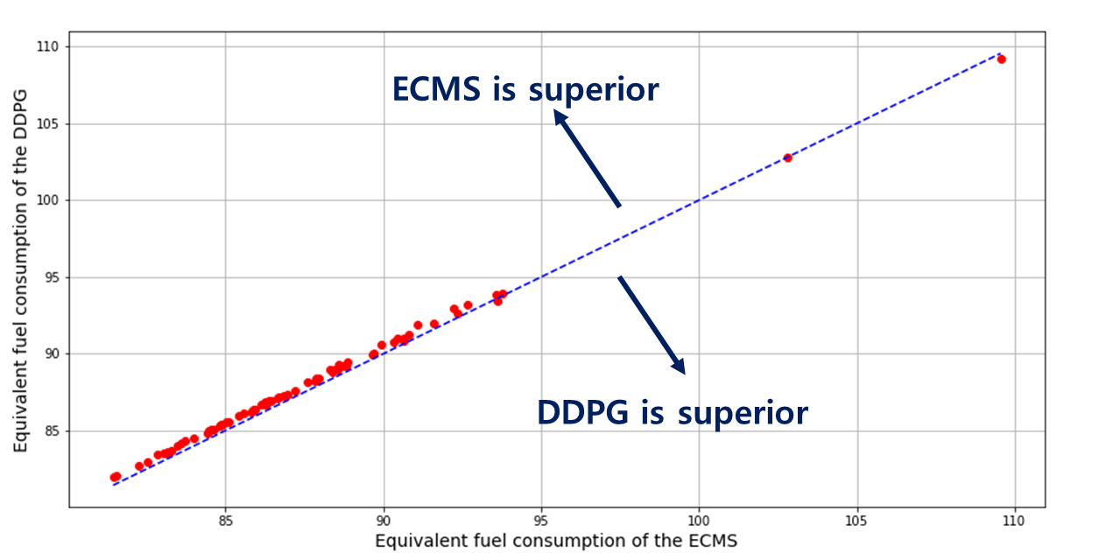
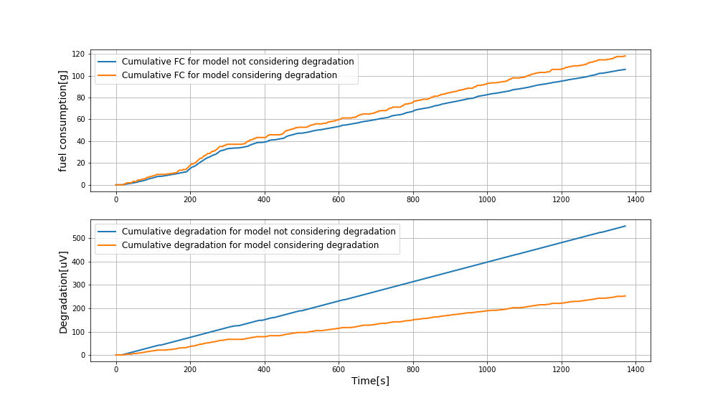
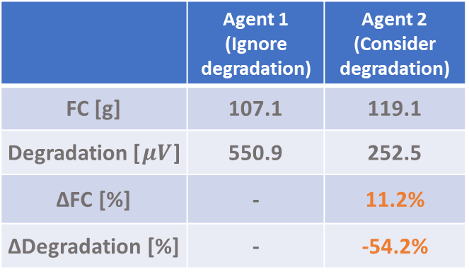

Development of energy management strategy for PEMFC-HEV considering
degradation of fuel cell system
Song Changhee¹⁾ · Cho Gu Young²⁾ · Cha Suk Won¹⁾
¹⁾Department of Mechanical Engineering, Seoul National University, ²⁾Department of Mechanical Engineering, Dankook University
Background
Research Background
A. Increased importance of fuel economy due to emission regulations
Electrification of the vehicles is accelerating
There is increasing interest in efficient fuel cell vehicles without emitting exhaust gas
B. Necessity of developing power distribution strategy (PDS) that guarantees generalization performance for Fuel Cell Hybrid Electric Vehicles (FCHEVs)
Optimal control theories have developed PDS considering future information
Since reinforcement learning (RL) derives a PDS considering only the current state, there is a growing interest in PDS for HEVs using the RL
C. PDS considering the deterioration of fuel cells
Since fuel cells are vulnerable to deterioration, it is necessary to develop the PDS that considers deterioration.
Research Objectives
PDS for FCHEVs development using deep reinforcement learning
B. PDS for FCHEVs development that guarantees generalization performance
C. Control Strategy development considering the fuel cell deterioration
Research
Experiments
Target Vehicle Middle size fuel cell hybrid vehicle
Deep Reinforcement Learning
DRL is composed on the Markov Decision Process (MDP) Framework consisting of an agent and an environment
In this study, we approach the DRL problem using the Actor-Critic algorithm
Definition of state, action, and reward:
State → $s=\left[P_{dmd}, ∆SOC, action_{prev}, j_{min}, j_{max}\right]$
Action → $a=current density for stack$
Reward → $r=−\left(\dot{m_{f}}+δ∙L\right)−γ\left|SOC−SOC_{ref}\right|$
FC stack
DC/DC
-
+
DC/AC
Battery
Motor
Properties | Values
Maximum stack power [kW] | 67
Maximum battery power [kW] | 40
Vehicle mass [kg] | 1200
Tire radius [m] | 0.337
Final gear ratio | 3.648
Initial SOC | 0.6
Results
Validation Test with ECMS (Equivalent Consumption Minimization Strategy)
When all driving information is given, the ECMS shows a performance close to the global optimum
We test the validity of the AC model through ECMS results given all driving information.
We confirm that our model shows results corresponding to ECMS
 | AC | ECMS
Number of wins | 3 / 72 (4.2%) | 69 / 72 (95.8%)
Biggest difference with ECMS (%) | +0.902 | -
Lowest difference with ECMS (%) | -0.303 | -
Average difference with ECMS (%) | +0.527 | -
 | Agent 1 (Ignore degradation) | Agent 2 (Consider degradation)
FC [g] | 107.1 | 119.1
Degradation [$μV$] | 550.9 | 252.5
∆FC [%] | - | 11.2%
∆Degradation [%] | - | -54.2%

